Slide 1

The Retirement Savings Crisis and the Role of ESOPs
  August 2025

Slide 2
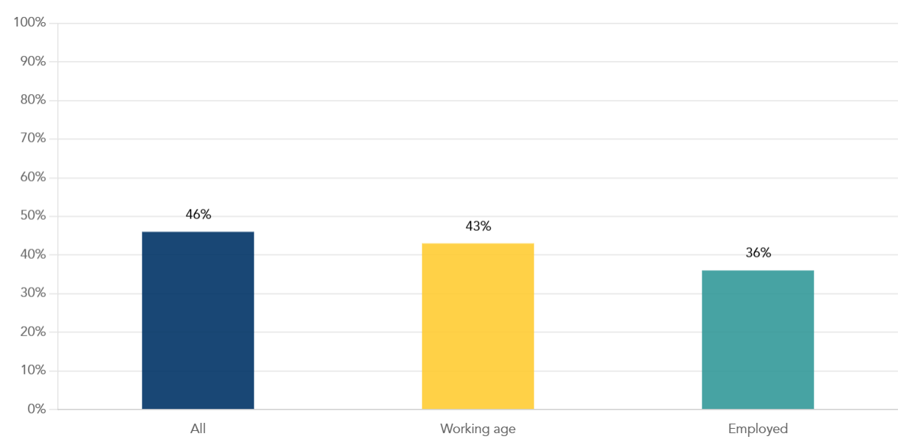
The most recent data from the Survey of Consumer Finances (SCF) on account holdings show that 46% of Americans have no retirement savings
Figure 1: Percentages with Zero Retirement Savings by Group
Source: NCEO analysis of SCF 2022 for all Americans, working age adults (18-64), and those currently employed (at least part-time).
1

Slide 3
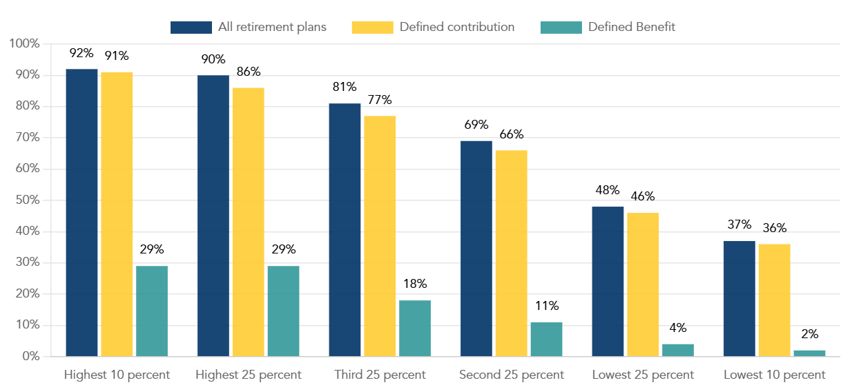
Access to retirement plans is strongly correlated to wages
Figure 2: Access rate to retirement plans for private industry workers by wage category
Source: U.S. Bureau of Labor Statistics. Spotlight on Statistics, 1974 – 2024: Celebrating 50 Years of Protected Retirement Plans. https://www.bls.gov/spotlight/2024/celebrating-50-years-of-protected-retirement-plans/
2

Slide 4
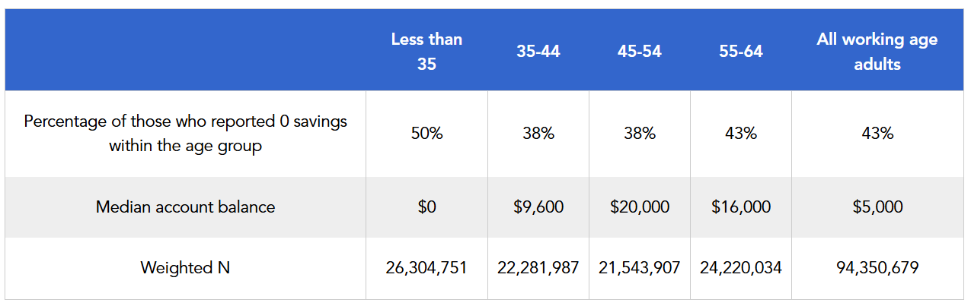
Since half of the group have no retirement savings, the median reported account balance is just $5,000 and zero for the youngest group
Table 1: Percentage of those who reported zero savings across age categories and their median account balances
Source: NCEO Analysis of SCF 2022
3

Slide 5
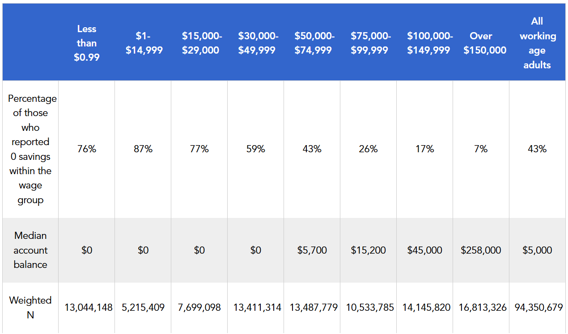
Looking at working age adults by wage groups demonstrates the strong correlation between savings and wages
Table 2: Percentage of those who reported zero savings across wage categories and their median account balances
Source: NCEO Analysis of SCF 2022
4

Slide 6
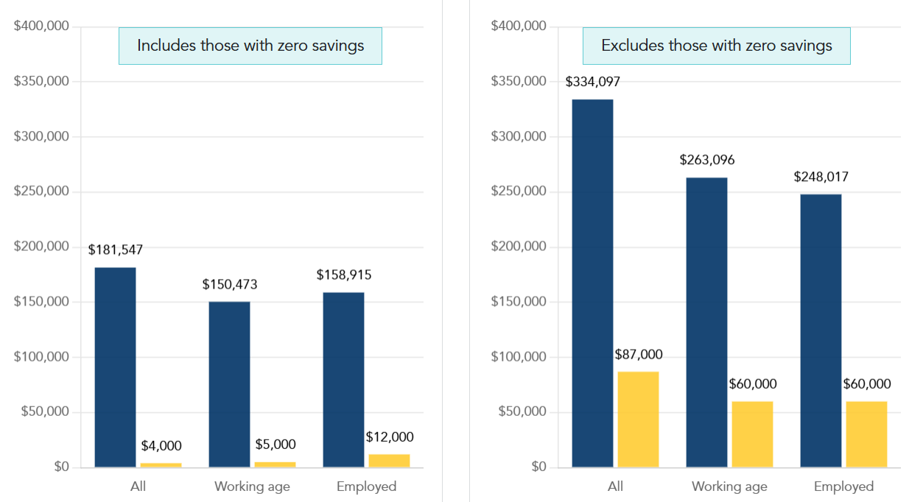
The figures below demonstrate the difference in the picture comparing data reporting the balances of all Americans versus data that just includes those that have at least some savings
Figure 3 and 4: Mean and Median Retirement Account Balances
Source: NCEO Analysis of SCF 2022
5

Slide 7
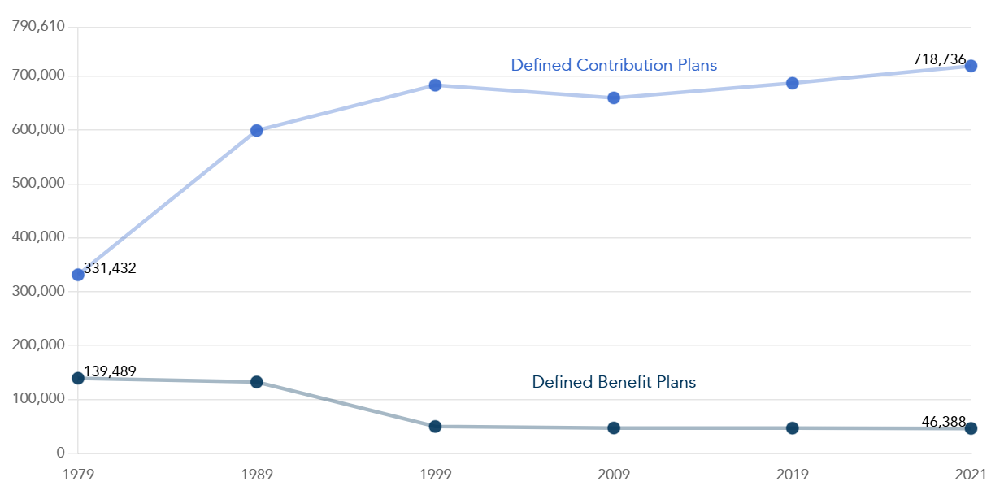
Both mean and median retirement savings reflect an income advantage
Figure 5: Changes in the number of Defined Benefit and Defined Contribution Plans, 1979-2021
Source: U.S. Government Accountability Office, 2019, The Nation's Retirement System: A Comprehensive Re-evaluation Needed to Better Promote Future Retirement Security. https://www.gao.gov/products/gao-19-342t
6

Slide 8
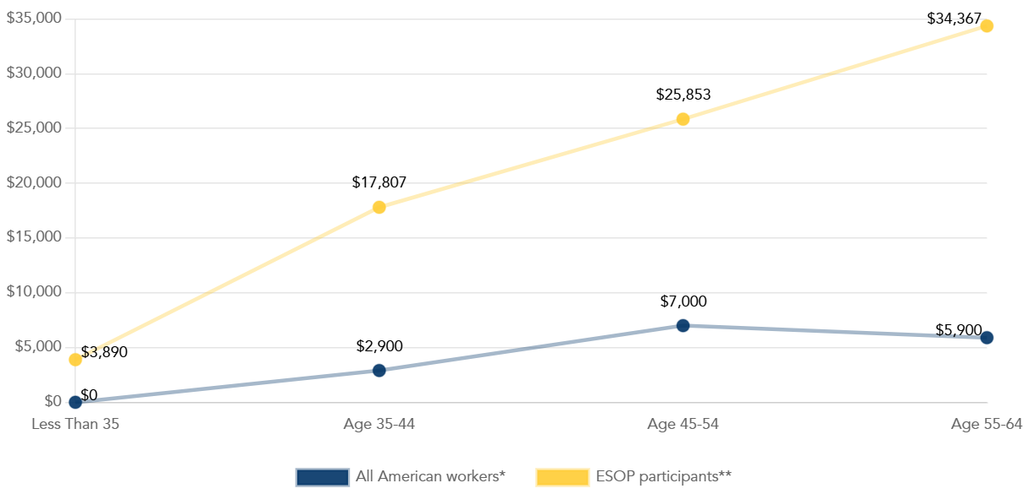
The figure below illustrates the ESOP benefit across age groups
Figure 6: Median balances for employed workers by age group*
Source: The Retirement Savings Crisis and the Role of ESOPs.
*The SCF data on income and retirement savings is self-reported and the Blue Ridge data on both is directly from administrative records. Since it is all workers, the SCF data includes those who report no retirement savings.
7

Slide 9
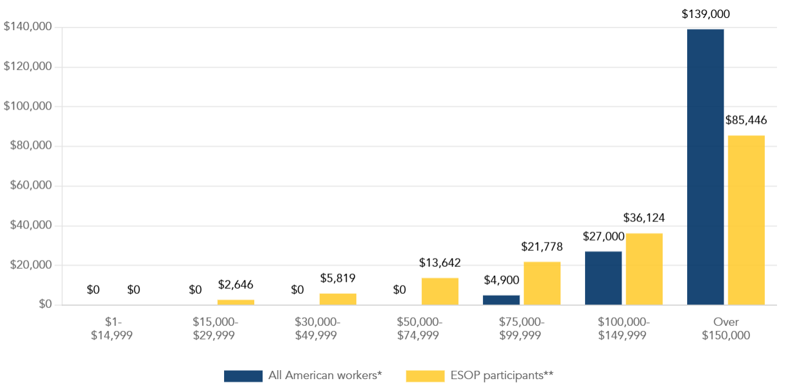
The figure below shows the sizable ESOP benefit for lower- and middle-income workers
Figure 7: Median retirement balances for employed workers by annual income from work*
Source: The Retirement Savings Crisis and the Role of ESOPs.
*The SCF data on income and retirement savings is self-reported and the Blue Ridge data on both is directly from administrative records. Since it is all workers, the SCF data includes those who report no retirement savings.
8

Slide 10
HAVE ADDITIONAL QUESTIONS OR COMMENTS?
  Please visit “The Retirement Savings Crisis and the Role of ESOPs”
  OR
  Contact the research team at research@nceo.org
9

