Slide 1








ESOPs by the Numbers
6,609
15,105,304
4,128
309
Participants covered,
with 10,999,997 current employees
Local communities contain at least 1 ESOP company
companies set up an ESOP in the most recent year
ESOPs across the US
Holding more than
ESOPs paid out
$2T
$166B
in total plan assets
in benefits in the most recent year
Source: NCEO analysis of DOL Form 5500 data for plan year 2023
www.nceo.org
01

Slide 2
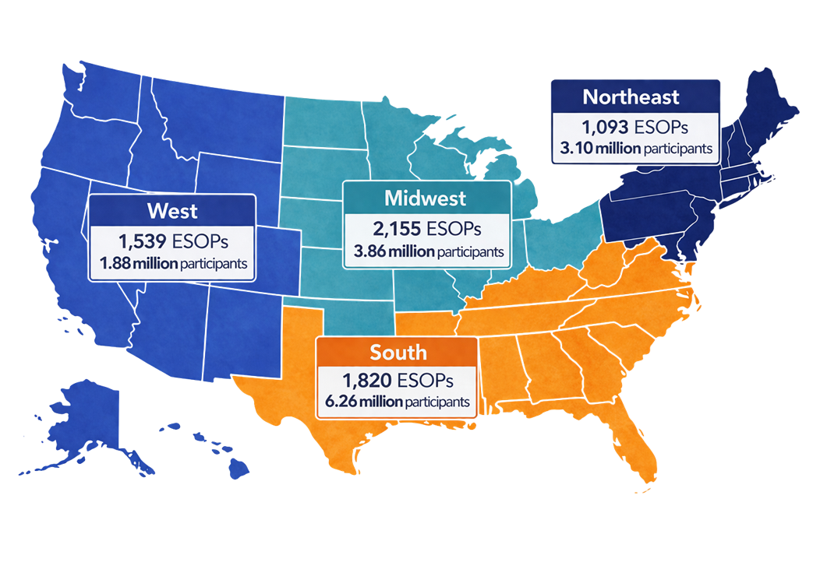
ESOPs by the Numbers
Spanning a wide range of industries:
Number of ESOPs and total participants covered across regions of the country:
Source: NCEO analysis of DOL Form 5500 data for plan year 2023
www.nceo.org
02

Slide 3


NCEO Research Team
Additional Research
Nancy Wiefek
Research Director
nwiefek@nceo.org
The Retirement Savings Crisis and the Role of ESOPs
The Employee Ownership 100
Employee Ownership and the Economy
Liza Shifrin
Senior Researcher
lshifrin@nceo.org
Contact the research department: research@nceo.org
www.nceo.org
02

