Slide 1
A Better Way Forward: NCEO Group Captive Solutions

Slide 2
Continuing Education Credit
The NCEO 2020 Employee Ownership Conference is eligible for continuing education credit.
To receive CE credit ensure that:
you are logged into the virtual conference under your own name.
you have signed in to collect CE via the NCEO’s google form
you answer the required polling questions during this session
Have questions? Contact eventhelp@nceo.org.

Slide 3
NCEO Group Captive Concept
What We Know
ESOP companies hire, train, communicate and retain employees better than non-ESOP companies.
ESOPs are more generous with benefits and more attuned to employee wellness and safety.
ESOPs are constantly looking for innovative ways to control costs and improve valuation.
These characteristics lead to stronger cultures, better loss performance, and better than average risk profiles.
Captives allow ESOPs to benefit from these advantages and retain and return more of their premium to their ESOP each year.

Slide 4
NCEO & Scott Partnership
Who is Scott?
Established in 1864; 100% employee owned since 1975
One of the largest independent insurance brokerage firms in the Southeast; 53rd largest broker in the U.S.
Nine offices across 4 states and a Best Practices Agency for 25 consecutive years
Clients with operations throughout the U.S. and internationally
Our Mission: To serve, protect and improve the lives of our colleagues and clients
How Did We Get Here?
Brief discussion with NCEO leadership at 2019 annual conference
Provided a basic “Captive 101” education and strategic roadmap for captive timing and partnership
Development of education and communication deliverables such as newsletters, blog posts, video, FAQ and webinars

Slide 5
NCEO Group Captive Concept
What are we trying to accomplish today?
Introduction to group captives
Discuss captive opportunity and ideal candidates
Basic “Captive 101” education for both Health Benefits and Casualty group captives
High-level discussion of the education and feasibility process
Provide timing and next steps
Where are we headed?
This is a process - exploring a captive takes time and each company will move at a different pace
Future educational opportunities
Future events

Slide 6
Why Do Companies Buy Insurance?
Required by law or contract (i.e. WC, GL, Auto, Health, ERISA, Etc.)
Fear of the large catastrophic loss
Defense of legitimate/fraudulent claims
Obligation to employee owners, customers, vendors, etc.

Slide 7







What is a Group Captive?
Group Captive

Slide 8
Lines of Coverage
Workers’ Compensation
General Liability
Automobile
Health

Slide 9
Ideal Candidate
Captive Owner
50 – 500 EEs and/or $20M in revenue
Entrepreneurial Spirit
Desire Control
Financially Secure
Loss Control & Safety Commitment

Slide 10


The Captive Community
Captive Owner
Grow Professional Networks
Accountability
Sharing Best Practices
Quarterly Calls
Member Meetings
New Idea Generation

Slide 11






Why Are We Here?
Little Control
Limited
Claims Info.
Unjustified Increases
Lack of Options
Little Transparency
COST

Slide 12

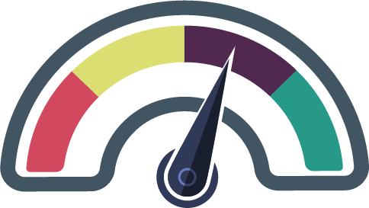


Funding Options
Group
Captive
Fully
Insured
Self-Funded
Rent
Own
Ownership

Slide 13



Your Options
 | Fully Insured | Self Funded | EB Captive
Available for Smaller Employers
Fixed Annual Payment
Plan Design Flexibility
Claims Information
Reward for Performance
Manageable Risk Level
Pricing Stability
Group Purchasing Power
Peer Group Support & Sharing

Slide 14





Are We a Good Fit?
Typically “Good” Claims Performance
Entrepreneurial Spirit
Desire Control
Care About Your Employees’ Health
Understand
“Risk for Reward”
Swim in a cleaner “pool”

Slide 15








Captive Structure
Stop Loss
Theirs
$400k
$325k
$325k
$300k
$300k
$300k
$285k
$285k
Stop Loss
$150k
Ours
Captive Layer
$75k
$75k
$50k
$35k
$50k
$50k
$35k
$35k
Captive
Mine
Company A
Company
B
Company
C
Company
D
Company
E
Company
F
Company
G
Company
H
Self-Insured
Individual Self-Insured Retention (SIR) Layer

Slide 16




Fully Insured vs. Captive
FULLY INSURED
CAPTIVE
$200,000
Fixed Expenses
$200,000
Captive Funding
$1,000,000
Fixed Expense
$600,000
Self-Insured Claims <$50k

Slide 17


Self Insured Opportunity
Expected
Actual
$200,000
Fixed Expenses
$200,000
Fixed Expenses
$200,000
Captive Funding
$200,000
Captive Funding
$500,000
Self-Insured Claims <$50k
$600,000
Self-Insured Claims <$50k
Total Pay In:
$900,000
$100,000
Savings

Slide 18



Captive Opportunity
Profit
$1,000,000
$9,000,000
50 Captive Members
$10M Captive Funding
90% Loss Ratio
2% Pro-Rata Performance Share
$20,000

Slide 19
Actual Spend
Expected
Actual
$200,000
Fixed Expenses
$200,000
Fixed Expenses
$200,000
Captive Funding
$200,000
Captive Funding
+$20,000
Captive
Distribution
$500,000
Self-Insured Claims <$50k
$600,000
Self-Insured Claims <$50k
Total Pay In:
$880,000
$120,000
Savings

Slide 20


Risk For Reward
Past 3 Years:
No company has hit the maximum
Expected
$200,000
Fixed Expenses
Maximum
$200,000
Captive Funding
X 25%
$50,000
(Cash Collateral)
$600,000
Self-Insured Claims <$50k
X 25%
$150,000

Slide 21


Protect Your Dollar
Opportunity
Self-Insured Claims
& Captive Funding

Slide 22



Clinical Risk 1-2-3
What is it?
Why do it?
1
$
Rx Carveout (20-25% Savings)
Rx Rebates
Employee Tools: Price Transparency & Concierge
Drive Down Cost/ Create Employee
“Skin in the Game”
Cost
Containment
2
Data Analytics
Biometric Screenings or Physician Forms
Identifying
Those Who
Are At-Risk
Risk
Identification
3
Targeted Clinical Programs to Improve Health Factor(s) with Incentives
Targeting &
Improving Those
Who Are At-Risk
Incentivized Risk
Reduction

Slide 23
Proven Results
Those in the Top 5% Engaged with Clinical Support
Doctor
Visits
Overall
Claims
ER Visits
Rx Drugs
38%
20%
5%
21%

Slide 24










What Does This Mean?
DAY
DAY
Employee
ID Card
Nationwide
Networks
SAME
TO
Broker Support
Plan
Design

Slide 25


Historic Performance
84%
3-year average of companies performing under expected
Self Insured
Performance
Average savings of $1,270 per employee per year.
$127,000
Average amount saved per 100 lives
SAME
89%
Captive
Performance
3-year average captive loss ratio
Average profit distribution $20,000 with a range of
$700-$105k per company.

Slide 26
Captive Goals
Fund for expected losses
Reinsurance for catastrophic or unexpected shock losses
Each company pays for own frequency losses
Minimize risk sharing

Slide 27
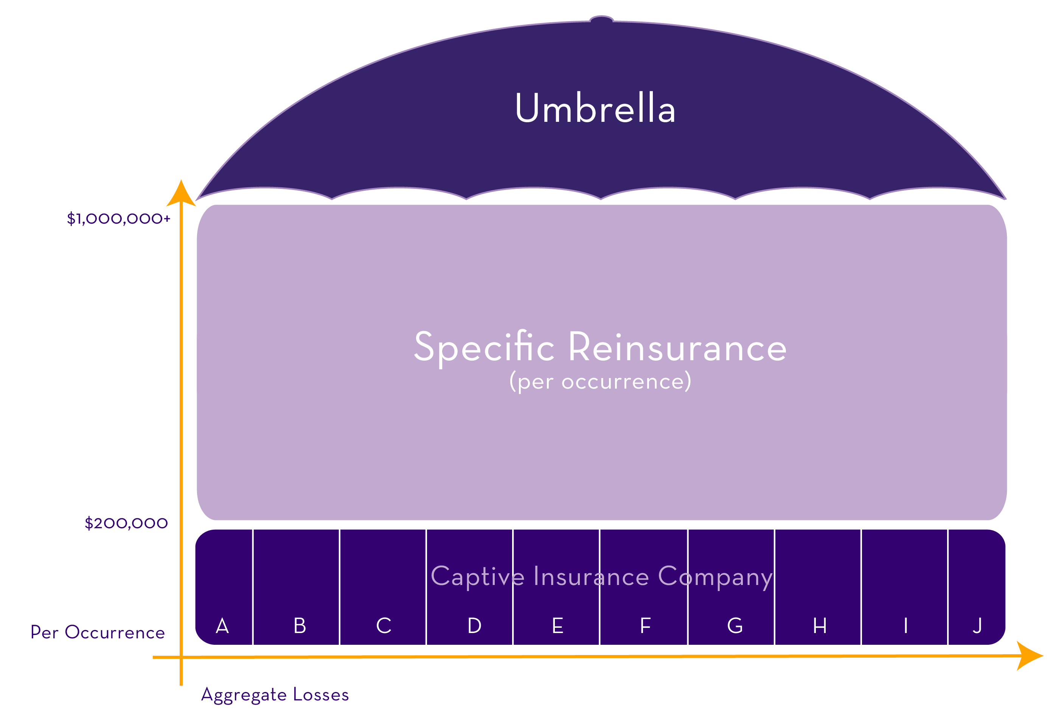
P&C Captive Structure

Slide 28
P&C Captive Structure
Shared Layer
$200,000
A
B
C
D
E
F
G
H
I
J
$75,000
ESOP Company Responsibility
$0
Captive Layer of Insurance

Slide 29
P&C Captive Structure
Board of Directors
Risk Control
Finance
Underwriting

Slide 30


Captive Premium
Loss Fund
Fixed Expenses
Actuary Determines
Fronting & Reinsurance
Based on Exposures & Claims History
Claims/Loss Control
Unique to Each Member
Captive Management

Slide 31
Sample Company
Fixed
$140,000
Loss Fund
$260,000
Total Premium = $400,000

Slide 32
Benefits of Captive Ownership
Control
Ownership
Partners
Operational Improvement
Best Practices
Relationships with Quality Business Owners
Returns
Underwriting Profit
Investment Income
Claims Process
Loss Experience/ Funding
Accountability

Slide 33
Year 1
$60,000
+
Investment Income
Year 2
Year 3
Year 4
Year 5
DISTRIBUTIONS BEGIN

Slide 34
Captive Considerations
Capital Contribution
Collateral Requirement
Potential to Share Risk
Assessment Potential

Slide 35
Year 1
Year 1 Collateral
$25,000 Capitalization
Year 2
Year 2 Collateral
Year 3
Year 3 Collateral
Year 4
Year 5
Three Year Stacking Collateral

Slide 36
“We learn from each other, so you know more about the industry and how to protect your workers and your company.” – Captive Member

Slide 37
“Our safety performance is better than it ever was. We do a better job of managing risk when we do have incidents and it’s certainly been financially beneficial.” – Captive Member

Slide 38
“If you have a strong safety company, you are subsidizing the weaker performers with the traditional insurance market. With captive insurance, we can capitalize on our strong safety performance.” – Captive Member

Slide 39
Next Steps
Education
Webinars, 1 on 1s, Captive 201s, Discussion of Process
5- Year ROI and Conceptual Proposal
ROI and Proforma Pricing
Underwriting Approval
Implementation
Founding Members Launch NCEO Captive
Risk Assessment

Slide 40

Thank you for attending “A Better Way Forward: NCEO Group Captive Solutions”
Visit https://www.nceo.org/insurance for more information.

Slide 41

We want to hear from you!
Thank you for attending this session.
Complete the session evaluation via the button on your screen.
Your feedback is greatly appreciated.

